Slide 1

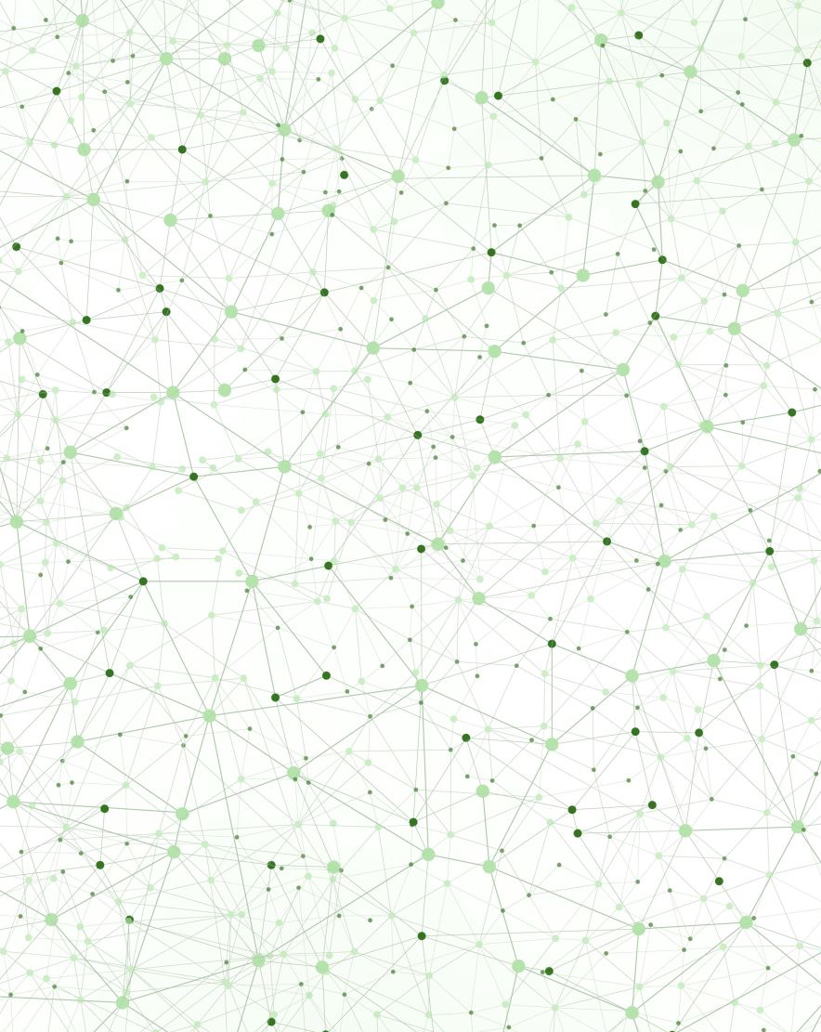

Mol-Optimizer Full Project Presentation
Amit Peled, Daniel Piro,
Shahar Alon & Nofar Rozenberg

Slide 2
What is MolOptimizer (MolOpt)?
Global Web-Application
Used by chemistry researchers in the field of small fragment-based inhibitors.
Indented to optimize ligand databases.
Aligning large ligand datasets.
Extracting large volume of chemical descriptors.
Predicts binding scores.
Developed at Akabayov Research Laboratories (under the supervision of Dr. Barak Akabayov).
Notes:
Amit
MolOpt is a global web-application that developed to be used by researchers working in the field of small fragment-based inhibitors and is intended to be helpful in optimization of ligand databases.
In other words, MolOpt helps researchers to enhance their analysis, understanding and optimization of ligands.
It can be used for Alignment of large ligand datasets, extracting large volume of Chemical Descriptors and training Machine Learning models to predict binding scores.
MolOpt was developed at Akabayov Research Laboratories (at BGU), Under the supervision of Dr. Barak Akabayov.

Slide 3

Project’s Motivation
Create the most user-friendly, easy to use web-application that will allow users from all over the globe to use the MolOptimizer tool.
We hope that this web-application will help anyone who use it, to achieve the best results he can get in the field of small fragment-based inhibitors.
Notes:
Amit

Slide 4
Project’s Main Requirements & Achievements
New Advanced, User Friendly & Responsive UI
Adding Users & Algorithm Runs Managements
Algorithms Writing, Repairing, Improvements & Optimizations.
Easy To Maintain/Add-on Tested Web-Application.
Notes:
Amit

Slide 5
Project’s Challenges & Overcomes
Frequent Requirements Changes.
Changes In The Professional Advisor In The Middle Of The Project.
Lack Of Prior Knowledge In Chemistry.
All of those, handled on the best side, with the assistance of Barak.
Notes:
Amit

Slide 6




Project’s Technical Information
Frontend
React JS
Material UI
Backend
Python (Django)
Notes:
Amit
On the frontend side
We used React JS and Material UI.
We used them for 2 main reasons:
React JS has the advantage to be connected easily to any backend code (based on previous experience we knew to use it for our purposes).
We found Material UI (MUI) to be the best package for a great looking and a user-friendly user-interface.
On the backend side
We used python (Django).
The main reason we use it was because the previous version of MolOpt was written in Python.
Therefore, we found it right to keep using Python in the current version of MolOpt.

Slide 7
User Interface
Frontend based on React JS & material UI.
code is fully integrated with all backend code.
User-friendly, Quick, Responsive ui.
Adjustable, fit & tested with every available web-browser.
Notes:
Daniel

Slide 8
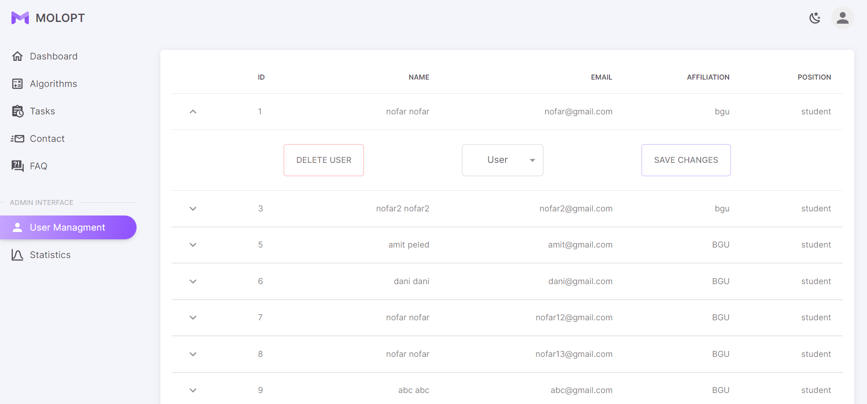
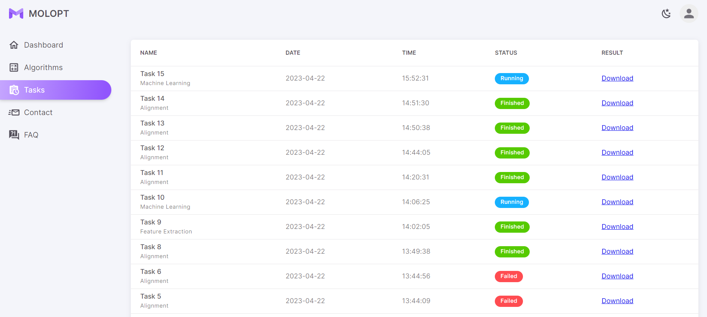
User Management & Runs Management
Photo of the users list (for admin only)
Photo of the tasks list (admin/regular user)
Notes:
Nofar

Slide 9
System’s Database
Capable for saving and working with multiple users and runs in the system.
Storing all the data of users and algorithm runs.
Kept updated at all times.
Notes:
Nofar

Slide 10
Algorithms Repairing, Improvements & Optimizations
Upgraded into a thread-based application.
Designing & implementing an algorithm runs queue.
Optimizing algorithms
Adding new run called “Auto-Process”.
Write, Fix & Improve All of MolOpt algorithms.
Notes:
Shahar
* Supporting all the features of the old version of MolOpt: Alignment, Feature Extraction & Machine Learning Algorithms.

Slide 11
System’s Tests/Maintenance/Add-ons
This projects followed by many documentations and tests that will allow the client to always keep the application fully functional.
Maintenance
The project is written in generic and easy to read way that will allow to add future features easily.
Easy To Add-on
- Used Django tests system. - Used Cypress package. Testing many cases of user cases in any web-browser.
Tests
Notes:
Amit

Slide 12
What is small fragment-based inhibitors?
Small fragment-based inhibitors refers to a specific class of molecules.
Small fragment-based inhibitors are small molecules designed to bind to specific protein or enzymes (other types of molecules) by occupying a small region on their surface.
They are advantageous due to their smaller size and ability to target less accessible protein surfaces.
These type of molecules are offering a starting point for drug discovery and can be optimized for better binding properties (that is where MolOpt comes in).
They play a significant role in developing therapeutics for various diseases.
Notes:
Amit

Slide 13
What is ligand / ligand databases?
Ligand
A Ligand is a molecule that binds to another molecule, often a protein.
(This is the type of molecules that belongs the fragment based-inhibitors).
Ligand databases
Ligand databases are collections of information about these molecules and their interactions with target molecules.
They provide data on the structure, properties, activities of ligands and their interactions with specific targets.
Researchers use these databases to study ligand-target interactions and aid in drug discovery and optimization.
Notes:
Amit

Slide 14
Time-codes for project demo presentation
Regular User
00:00 – 03:15: Creating a new user + login with that user + web overview + alignment example with results + user profile + logout.
Admin User
03:30 – 04:20: User Management (+ dynamic paging tables view).
04:25 – 04:35: Statistics.
04:35 – 06:40: Algorithm Runs.
06:40 – 08:15: Runs Results.
08:20 – 09:20: Tests.
Notes:
Amit

Slide 15

Thank You! ☺

